Slide 1
RSM222
Management Accounting 1
Class 6: Costing Systems – Variable Costing
Elisa Zuliani

Slide 2
Learning Objectives of Class 5
Identify how variable costing differs from absorption costing, and compute unit product costs under each method.
Prepare income statements using both variable and absorption costing.
Understand the effect of changes in sales and production on operating
income under both methods.
Explain the advantages and disadvantages of both variable and absorption costing.

Slide 3
Product Costing
Variable Costing

Slide 4
Absorption vs Variable Costing
Fixed MOH treatment is the difference.
Absorption Costing
Variable Costing
Direct Materials
Product Costs
Direct Labour
Product Costs
Variable Manufacturing Overhead
Fixed Manufacturing Overhead
Variable Selling and Administrative
Expenses
Period Costs
Period Costs
Fixed Selling and Administrative Expenses

Slide 5
Let apply…
Which method will produce the highest values for work in process and finished goods inventories?
  a. Absorption costing.
  b. Variable costing.
  c. They produce the same values for these
  inventories.
  d. It depends. . .

Slide 6
Let apply…
Which method will produce the highest values for work in process and finished goods inventories?
  a. Absorption costing.
  b. Variable costing.
  c. They produce the same values for these
  inventories.
  d. It depends. . .
  Absorption costing allocates some fixed manufacturing overhead to units on the balance sheet. These fixed costs are treated as a period expenses under variable costing.

Slide 7



Case Study – How does Costing Method Impact Profits?
“It’s no secret that in the years leading up to 2008, the Big Three automakers — Ford, General Motors, and Chrysler — were producing above market demand.”
What was the incentive?
Because Absorption Costing considers all fixed costs as part of the cost of goods sold, it gives companies an incentive to spread that cost among more products to make the cost-per-product appear lower.
If the company has excess capacity, produces all the products it can, and sells up to demand, its cost of goods sold will be lower than it would if the company had only produced up to demand.
This lower cost boosts profits on the income statement. Instead of writing off the cost of these idle plants as an expense, companies shift it to the balance sheet as inventory.

Slide 8
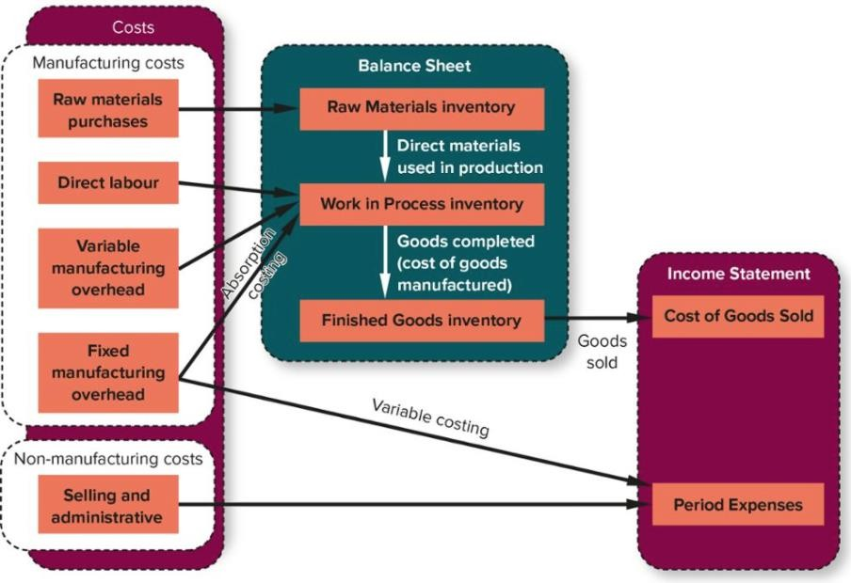
Fixed MOH Deferred in Inventory
Including fixed overhead as a cost of the product ensures the fixed overhead is expensed (as part of cost of goods sold) when the sale is reported.
  Carrying over inventories and overhead costs is reflected in the ending inventory balances at the end of the production period, which become the beginning inventory balances at the start of the next period.

Slide 9
Deferred Costs Example
Assume a new company has fixed overhead of $12,000 and manufactures 10,000 units. Direct materials cost is $3 per unit, direct labor is $15 per unit, and the variable manufacturing overhead is $7 per unit.
 | Absorption | Variable
DM ($3/unit * 10,000 units) | $30,000 | $30,000
DL ($15/unit * 10,000 units) | $150,000 | $150,000
VMOH ($7/unit * 10,000 units) | $70,000 | $70,000
FMOH | $12,000
Total Finished Goods Inventory | $262,000 | $250,000
Cost per Unit in Inventory | $26.20/unit | $25/unit

Slide 10
Deferred Costs Example
Assume each unit is sold for $33 each.
 | Absorption
Sales | $330,000
COGS | $262,000
Gross Profit | $ 68,000
SG+A
Net Income | $ 68,000
 | Variable
Sales | $330,000
Variable Costs | $250,000
Contribution Margin | $ 80,000
Fixed Costs | 12,000
Net Income | $ 68,000
Absorption NI = Variable NI

Slide 11
Absorption Costing
Unit product
cost.

Slide 12
Variable Costing
Unit product
cost.

Slide 13
Deferred Costs Example
Assume 8,000 units are sold for $33 each. 2,000 units remain in ending inventory.
 | Absorption
Sales | $264,000
COGS ($26.20 per Unit) | $209,600
Gross Profit | $54,400
SG+A
Net Income | $54,400
 | Variable
Sales | $264,000
Variable Costs ($25 per Unit) | $200,000
Contribution Margin | $64,000
Fixed Costs | $12,000
Net Income | $52,000
Absorption NI > Variable NI
This will reverse when inventory is sold

Slide 14
Absorption Costing
Unit product
cost.

Slide 15
Variable Costing
Unit product
cost.

Slide 16
Comparative Income Effects of Absorption and Variable Costing
Relation between Production and Sales | Effect on Inventory | Relation between Variable and Absorption Income
Production > Sales | Inventory Increases | Absorption NI > Variable NI
Production < Sales | Inventory Decreases | Absorption NI < Variable NI
Production = Sales | No Change | Absorption NI = Variable NI
Will the effect automatically reverse in next period?

Slide 17
Advantages of the Variable Costing Method
Fixed manufacturing overhead costs will be incurred regardless of whether anything is actually produced.
Advantages
More useful for CVP analysis.
Reduces the incentive to build up inventory by shifting costs to the next period.
Closer approximation of net income to cash flows
More Useful for Decision Making
  Fixed costs are more visible.
So why do we have Absorption Costing?

Slide 18
Disadvantages of the Variable Costing Method
The variable cost method is not acceptable for financial reporting under GAAP/IFRS.
  Accounting Standards requires expenses to be recognized in the same period as the related revenue, and the variable method expenses fixed overhead as a period cost.
IAS 2
Inventories shall be measured at the lower of cost and net realisable value. The cost of inventories shall comprise all costs of purchase, costs of conversion and other costs incurred in bringing the inventories to their present location and condition.
  (13): The allocation of fixed production overheads to the costs of conversion is based on the normal
capacity of the production facilities.
  Normal capacity is the production expected to be achieved on average over a number of periods or seasons under normal circumstances. Actual level of production may be used if it approximates normal capacity.
See the loophole?

Slide 19
Any Questions?

